Slide 1
Neural FCA: Dataset Analysis and Performance Evaluation
Presented by ‘MUHAMMAD SULIMAN
Date: 10-DECEMBER-2024

Slide 2
Objective of the Study
Neural FCA combines Neural Networks and Formal Concept Analysis to improve interpretability.
Motivation: Interpretability is crucial in machine learning to understand predictions.
FCA uncovers relationships in data, adding reasoning to predictions.

Slide 3
Dataset Overview
US Electricity Dataset:
Features: Demand.Summer Peak, Sources.Total, Uses.Total.
Objective: Predict electricity demand categories.
World Population Dataset:
Features: Growth Rate, Density (per km²), 2022 Population.
Objective: Analyze population growth trends.
DS Salaries Dataset:
Features: salary_in_usd, experience_level, employment_type.
Objective: Predict salary ranges.

Slide 4
Binarization Process
- Categorical Data: One-hot encoding converts categories to binary columns.
- Numerical Data: Divided into intervals using custom functions.
def NumOneHotEncoder(column, n_intervals, feature_name):
min_val, max_val = column.min(), column.max()
step = (max_val - min_val) / n_intervals
bins = [min_val + i * step for i in range(n_intervals + 1)]
labels = [f"{feature_name}_{i}" for i in range(n_intervals)]
binarized = pd.get_dummies(pd.cut(column, bins=bins,
labels=labels))
return binarized
The NumOneHotEncoder function converts a numerical column into binary columns using one-hot encoding. It divides the column into n_intervals bins by calculating the range and step size, labels each bin (e.g., feature_0, feature_1), and uses pd.cut to assign values to bins. Finally, pd.get_dummies creates binary columns for these bins, producing a DataFrame where each row represents the original value's membership in the bins. This prepares numerical data for machine learning models in a structured way.

Slide 5
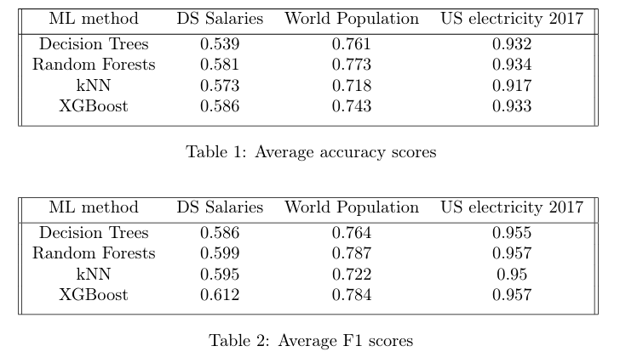
Performance of Standard ML Models
Performance Across Standard ML Models and Datasets
Compare standard ML models (Decision Trees, Random Forests, kNN, XGBoost).
These tables compares the performance of standard ML models (Decision Trees, Random Forests, kNN, and XGBoost) across datasets. Results show Random Forests and XGBoost performing consistently well.

Slide 6
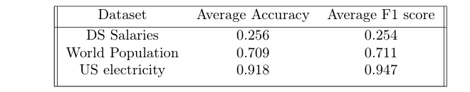
US Electricity Results (US Electricity Dataset Results)
Neural FCA: Accuracy ~91.8%, F1 ~94.7%.
Standard ML Models: Accuracy ~93.4%, F1 ~95.7%.
Insight: The US Electricity dataset demonstrates
Neural FCA’s strengths in structured data,
achieving comparable results to standard models
Table 5: Focus on the average (accuracy and F1) for Neural FCA on the US Electricity dataset.

Slide 7
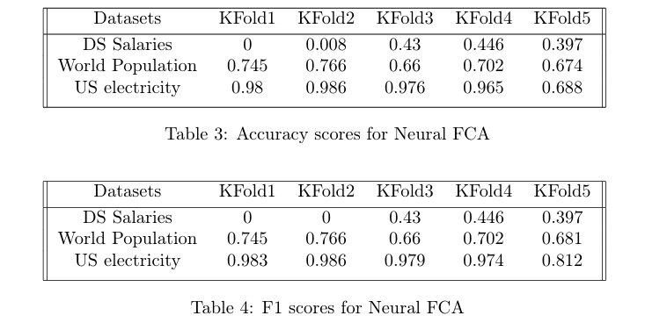
World Population Results (World Population Dataset Results)
Neural FCA: Accuracy ~70.9%, F1 ~71.1%.
Standard ML Models: Accuracy ~77.3%, F1 ~78.7%.
Insight: Neural FCA performs reasonably well on the
World Population dataset, though slightly behind
standard ML models.
K-Folds: "Model performance was evaluated using
5-fold cross-validation to ensure robust and unbiased
results. Metrics are averages across all folds.

Slide 8
DS Salaries Results (DS Salaries Dataset Results)
Neural FCA: Accuracy ~25.6%, F1 ~25.4%.
Standard ML Models: Accuracy ~58.6%, F1 ~61.2%.
Insight: Neural FCA struggled with the DS Salaries
dataset, achieving poor metrics due to the complexity
of the salary range. Standard ML models
outperformed Neural FCA significantly.
K-Folds: "Despite using 5-fold cross-validation to
evaluate models, Neural FCA struggled due to the
dataset’s wide numerical range and complex feature
interactions.

Slide 9
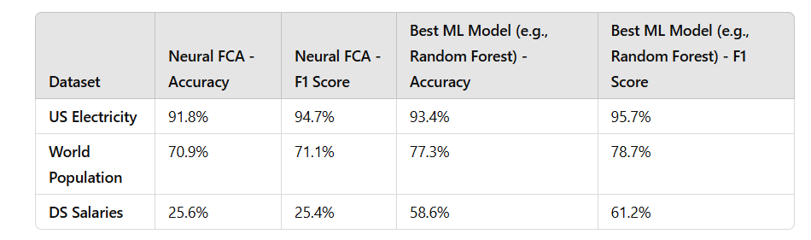
Performance Comparison (Neural FCA vs. Standard ML Models: Overall Comparison)
Strengths of Neural FCA:
Offers interpretability, making predictions more transparent.
Performs well in structured datasets like US Electricity.
Weaknesses of Neural FCA:
Struggles with complex datasets (e.g., DS Salaries) due to wide numerical ranges and feature interactions.
Slower execution time compared to standard ML models.
Strengths of Standard ML Models:
Consistently high performance across all datasets.
Better suited for complex datasets without interpretability constraints.

Slide 10
Challenges in Neural FCA
Challenge: "One of the key issues encountered in Neural FCA was the use of the 'Sofia' algorithm instead of 'Cbo' due to time constraints. While 'Sofia' allowed faster computation, it potentially impacted the accuracy and interpretability of the concept lattice.
Implication: "The use of Sofia highlights the trade-off between execution speed and quality of results. Future optimizations could explore ways to improve the speed of 'Cbo' or enhance 'Sofia' for better lattice structures.

Slide 11
Conclusion
Summary:
Neural FCA is effective for interpretability but lags in performance
compared to standard models in complex datasets.
2. Excels in structured datasets like US Electricity.
Future Work:
Experiment with fewer bins for large numerical ranges (e.g., salaries).
Optimize Neural FCA for faster execution.

Slide 12
Questions
Thank you! Feel free to ask questions or share feedback.

